Slide 1
Title
Virtualization: Writing (and testing) device drivers without hardware
PJ Waskiewicz,
Shannon Nelson,
LAN Access Division,
Intel Corp.

Slide 2
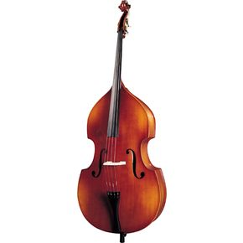
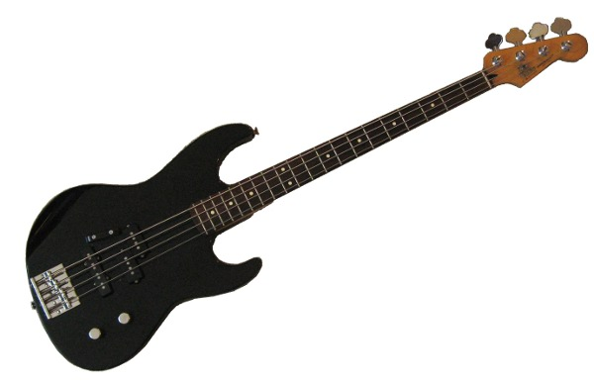
Who Are We
PJ Waskiewicz
  Linux developer in LAN Access Division
  Working on next-gen 40 GbE product
  Plays classical string bass
Shannon Nelson
  Linux developer in LAN Access Division
  Working on next-gen 40 GbE product
  Plays rock&roll electric bass

Slide 3

Overview
Motivations
SW without HW
HW Emulation and why do we care
Shift left with QEMU
Example of building a device in QEMU
Next Steps

Slide 4
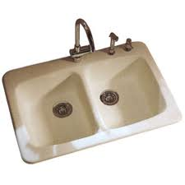
Networking++
Fast networking...
  40Gbs is the new frontier for data center communications
… that does everything…
  All the normal ethernet tricks
  Bakes a great apple pie
  Can leap tall buildings in a single bound
… and has market scheduling targets
  What else is new?
Don't forget the new Shift Left!

Slide 5
Shift Left
Hardware + Software = Complete product
Feature-complete software by A-0 silicon
Software needs to happen earlier
HW Schedule
SW Schedule
HW Schedule
SW Schedule

Slide 6

Write SW without the HW?
Product in early design when “Shift Left” happened
Driver developers challenged to be “Code Complete” with new features when A0 arrives
HW spec not yet solidified
Oh crap, now what?
Hardware emulation to the rescue!

Slide 7
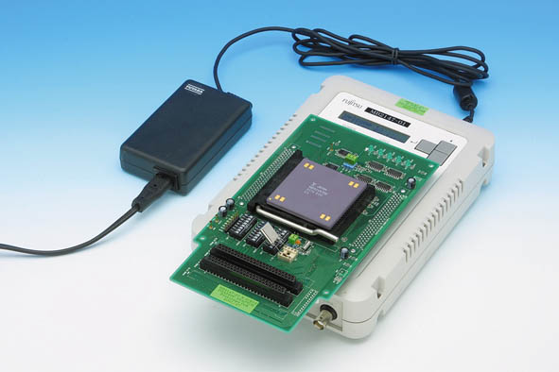
LAD’s Hardware emulation so far
FPGAs
  $$$
  Planned, but in stages that don't match SW's Shift Left schedule
  Requires working RTL which won't be ready soon
RTL simulator
  $$$$$
  Requires working RTL
  Typically can load native drivers
Software emulator (bus function driver)
  Windows only, not portable to multiple OS's

Slide 8

How about QEMU/KVM Emulation?
HW System emulation in Virtual Machines
  QEMU emulates many systems
  KVM gives Linux kernel support for VM acceleration
Supports many hardware types and peripherals
  X86 and other architectures
  Various network and other devices
Supports many OS’s in VMs
  Windows, Linux, BSD
Open source
  We can modify the existing internals
  We can add our own!

Slide 9
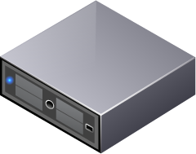
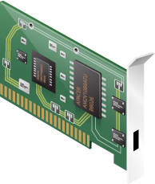
QEMU: Emulation and Virtualization
QEMU runs as Linux user process
QEMU Shell
QEMU Shell
Linux kernel

Slide 10
QEMU: Emulation and Virtualization
QEMU runs as Linux user process
Guest OS runs in QEMU shell
QEMU Shell
QEMU Shell
Guest OS
Guest OS
Linux kernel

Slide 11
QEMU: Emulation and Virtualization
QEMU runs as Linux user process
Guest OS runs in QEMU shell
Guest OS “sees” HW presented by QEMU shell
QEMU Shell
QEMU Shell
Guest OS
Guest OS
Emulated HW
Emulated HW
Linux kernel

Slide 12
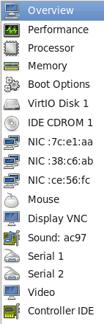
QEMU: Emulation and Virtualization
QEMU Shell
QEMU Shell
Guest OS
Guest OS
Emulated HW
Emulated HW
Linux kernel

Slide 13
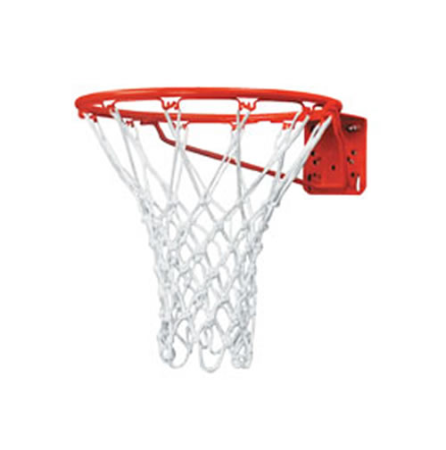
Goals
Support Linux and Windows driver development
  Emulate the device register set
  Emulate basic device functionality
  Give feedback to HW designers
  Try to make it useful for other OS's as well
Don't worry about being perfect
  Don't need high performance
  Don't need every single planned feature

Slide 14

Creating a new device
Start with existing e1000 emulation
Match device requirements with HW specs
Implement different packet descriptor formats
Implement firmware doorbell registers
Register PCI BARs
Add device specific features
Many more...

Slide 15
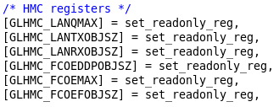
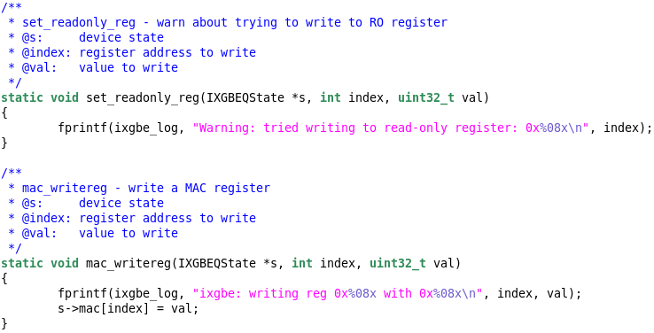
Simple code example
Attach R/O register to callback
QEMU traps MMIO write
Notes:
-Point out on the right that this can catch and log when we try and write a read-only register. This can find buggy drivers well in advance of seeing hardware. Plus, hardware doesn't typically return an error when writing read-only registers, and in some cases, hardware goes south with no explanation when this happens.

Slide 16
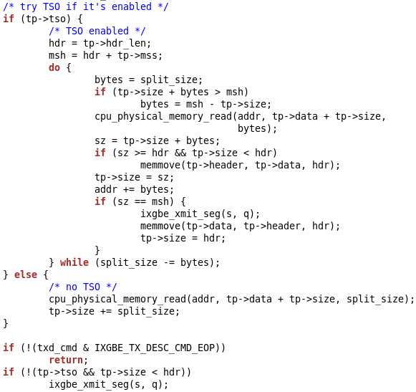
More complex example
Use RFC for TSO to implement logic
Follows internal device logic
Notes:
- Dig into the HMC configuration on the left. This is the flow when a transmit descriptor ring is enabled.

Slide 17
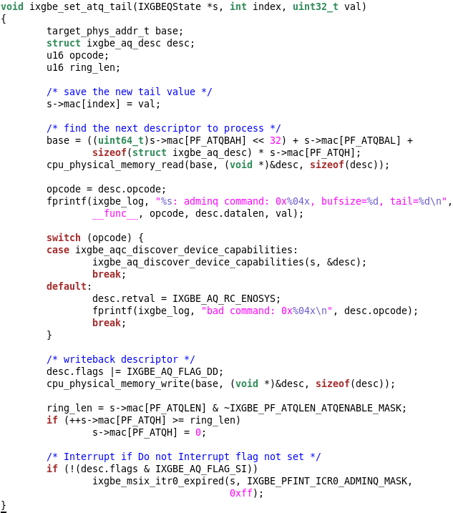
“Implementing” Firmware
Firmware comprised of command descriptor, doorbell
Fill out descriptor, ring doorbell
Process descriptor, writeback result

Slide 18
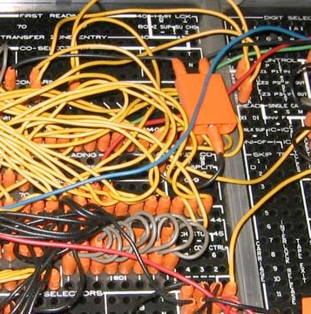
“Messing” with the device
Unit test framework inside product model
Hooked to dummy register
Can be used to inject errors, among other things
Another dummy register to change PF behavior
Verifies multifunction device behavior

Slide 19
Impact in LAD
OS Drivers are already operational
  Hotpaths are being exercised
  HW design ideas being proven in SW
Dozens of bugs found and fixed in multiple OS drivers
  First bugs found and fixed months prior to scheduled initial FPGA arrival
HW Test and Diagnostics tools built against emulation
Other network product groups beginning to use the model

Slide 20

Benefits to Intel
Much more likely to hit schedule
  Enables maximum Shift Left
Better complete SW/HW product
  Everything gets better/earlier review
Can be applied to other HW products
  Modeling peripherals probably easiest
  Modeling CPU behaviors may be more challenging

Slide 21

Extra Benefits
HW team getting Shift Left benefits
  HW SV folks testing their tools on our emulator
Diagnostics, SW test, and support folks as well
  Enough driver and emulator working for all to Shift Left
VMs are easier to restart after a crash
  Faster development turnaround
  Allows for remote development
Open software is “free” (as in beer)
  Cost is Intel engineering time to build emulation
  Result could be returned to community, assist Design Wins
Build Kernel infrastructure sooner

Slide 22
Next Steps
Limited implementation of advanced features
Support preboot driver development
Explore integrating RTL into backend
Explore running “real” firmware engine
Expand to other LAD product lines

Slide 23

Enhancing QEMU
Push device “stub” into QEMU to support this model
Implement true firmware core in QEMU. Tensilica? ARC?
Implement easier RTL integration for future use

Slide 24

Lessons Learned
Emulating hardware has given much better insight into hardware operation, leading to better designed drivers
Emulating early allowed us to test changes in hardware architecture for sanity and have meaningful input to that architecture
Having an emulator this early allowed the entire extended product team to collaborate closer much earlier than previous projects

Slide 25
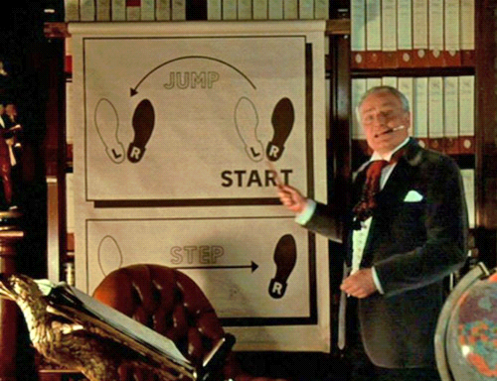
Questions?

Slide 26
